Slide 1
Charan N Data Visualizations Using Excel Telecom Churn Dataset

Slide 2
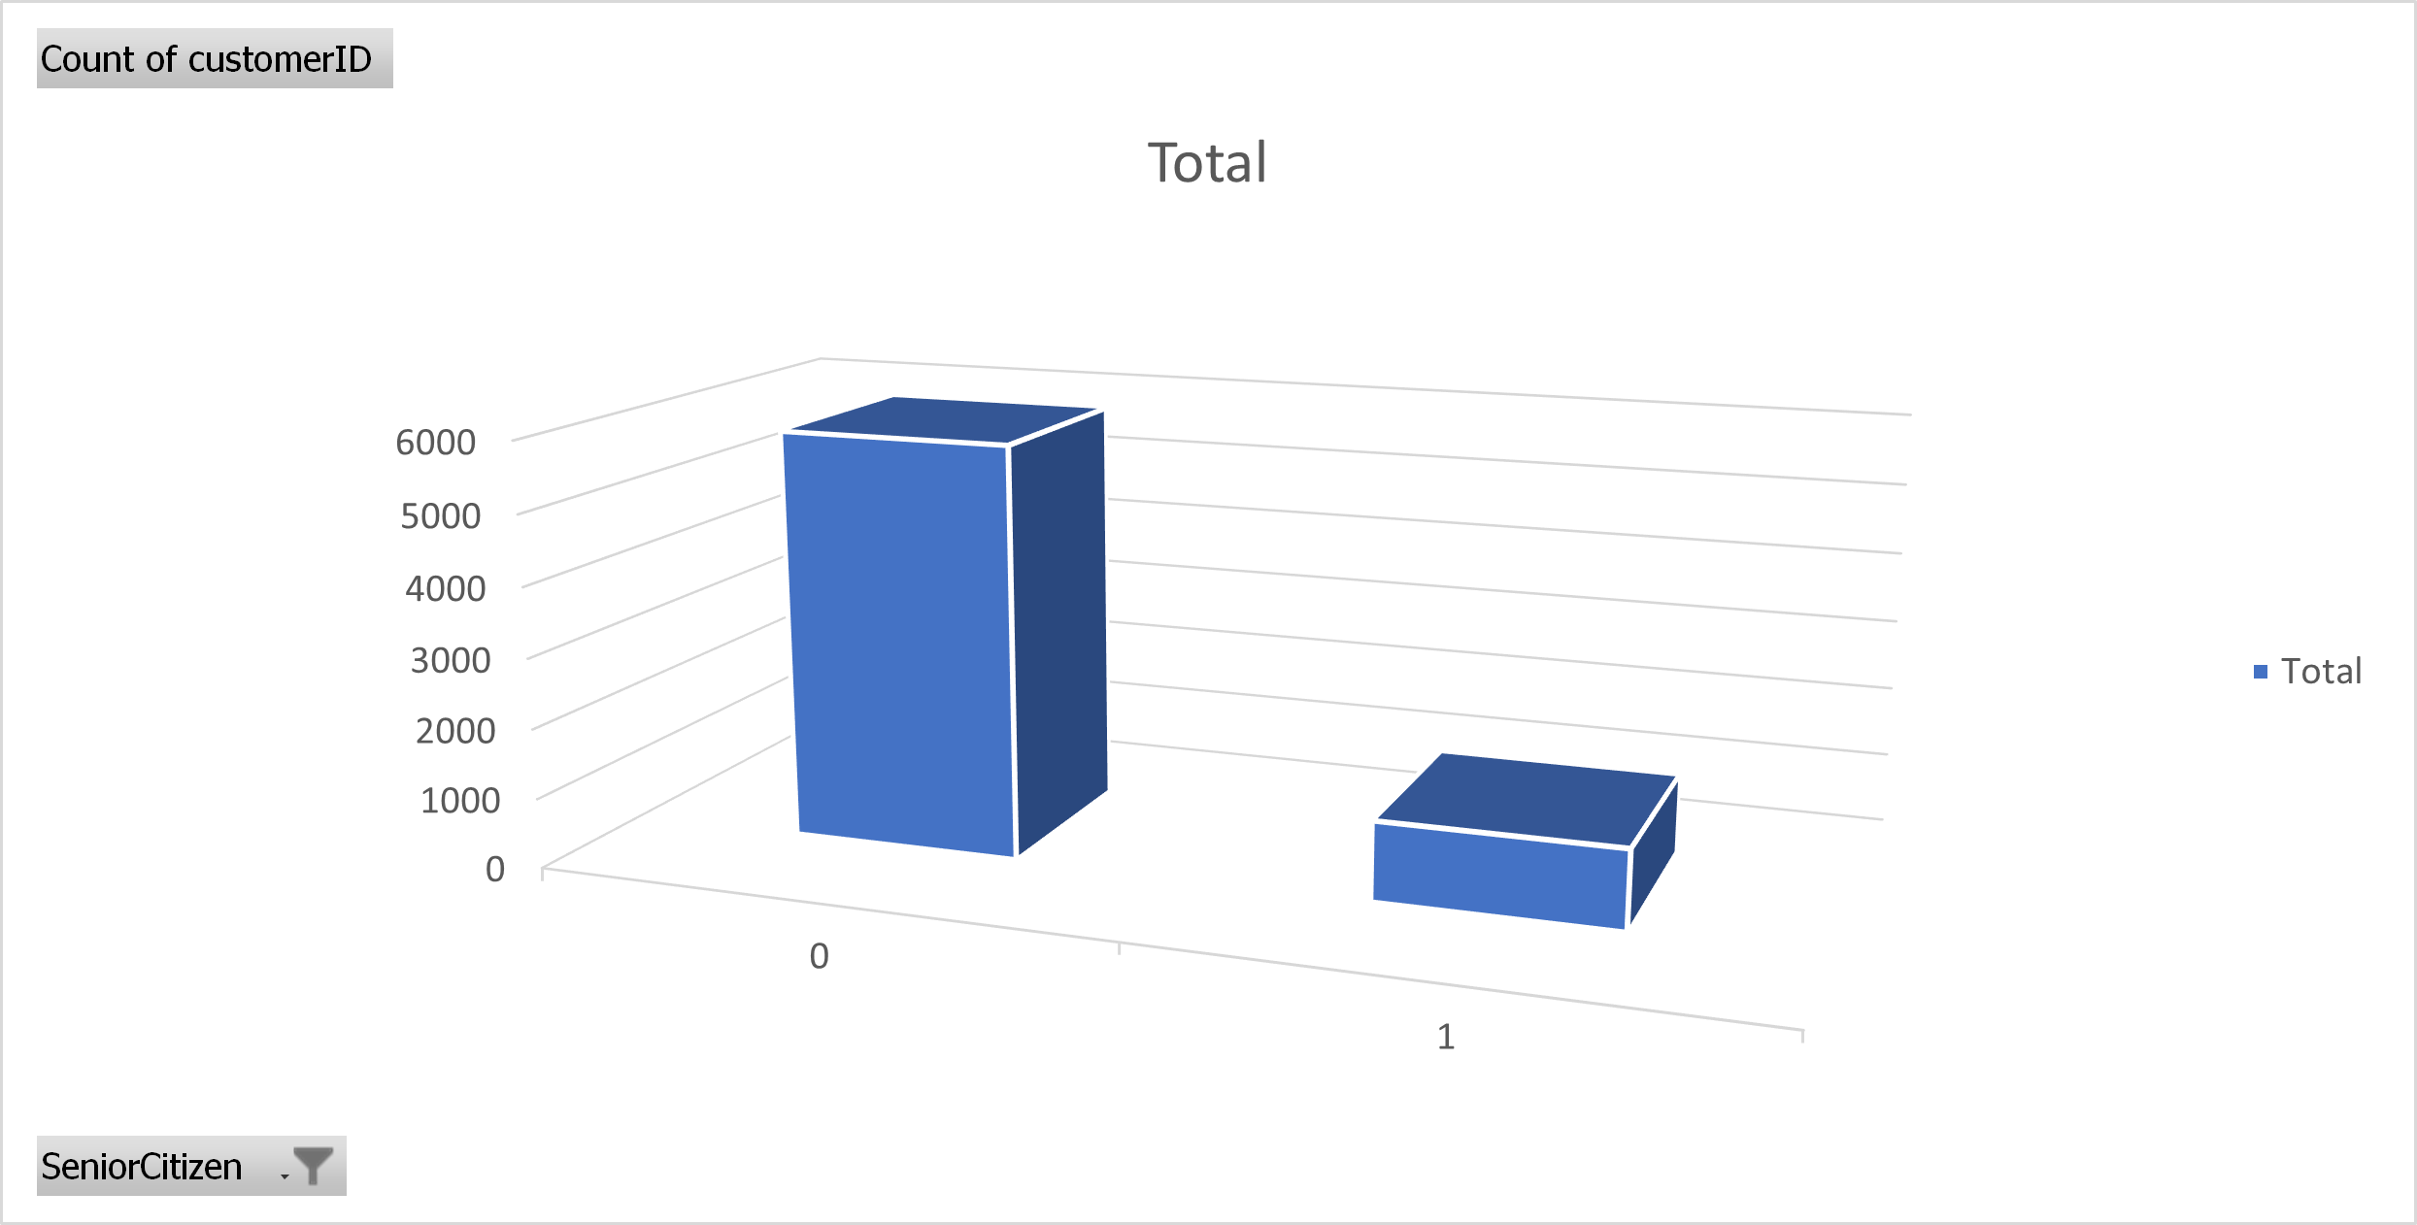
1. Whether Senior Citizen Churn Or Not? Can This Telecom Company Suggested To People Belong To Senior Citizen Category?
Row Labels | Count of customerID
0 | 5147
1 | 1864
Grand Total | 7011
This the total number of people churn or not. 5147 doesn’t churn and 1864 churned.

Slide 3
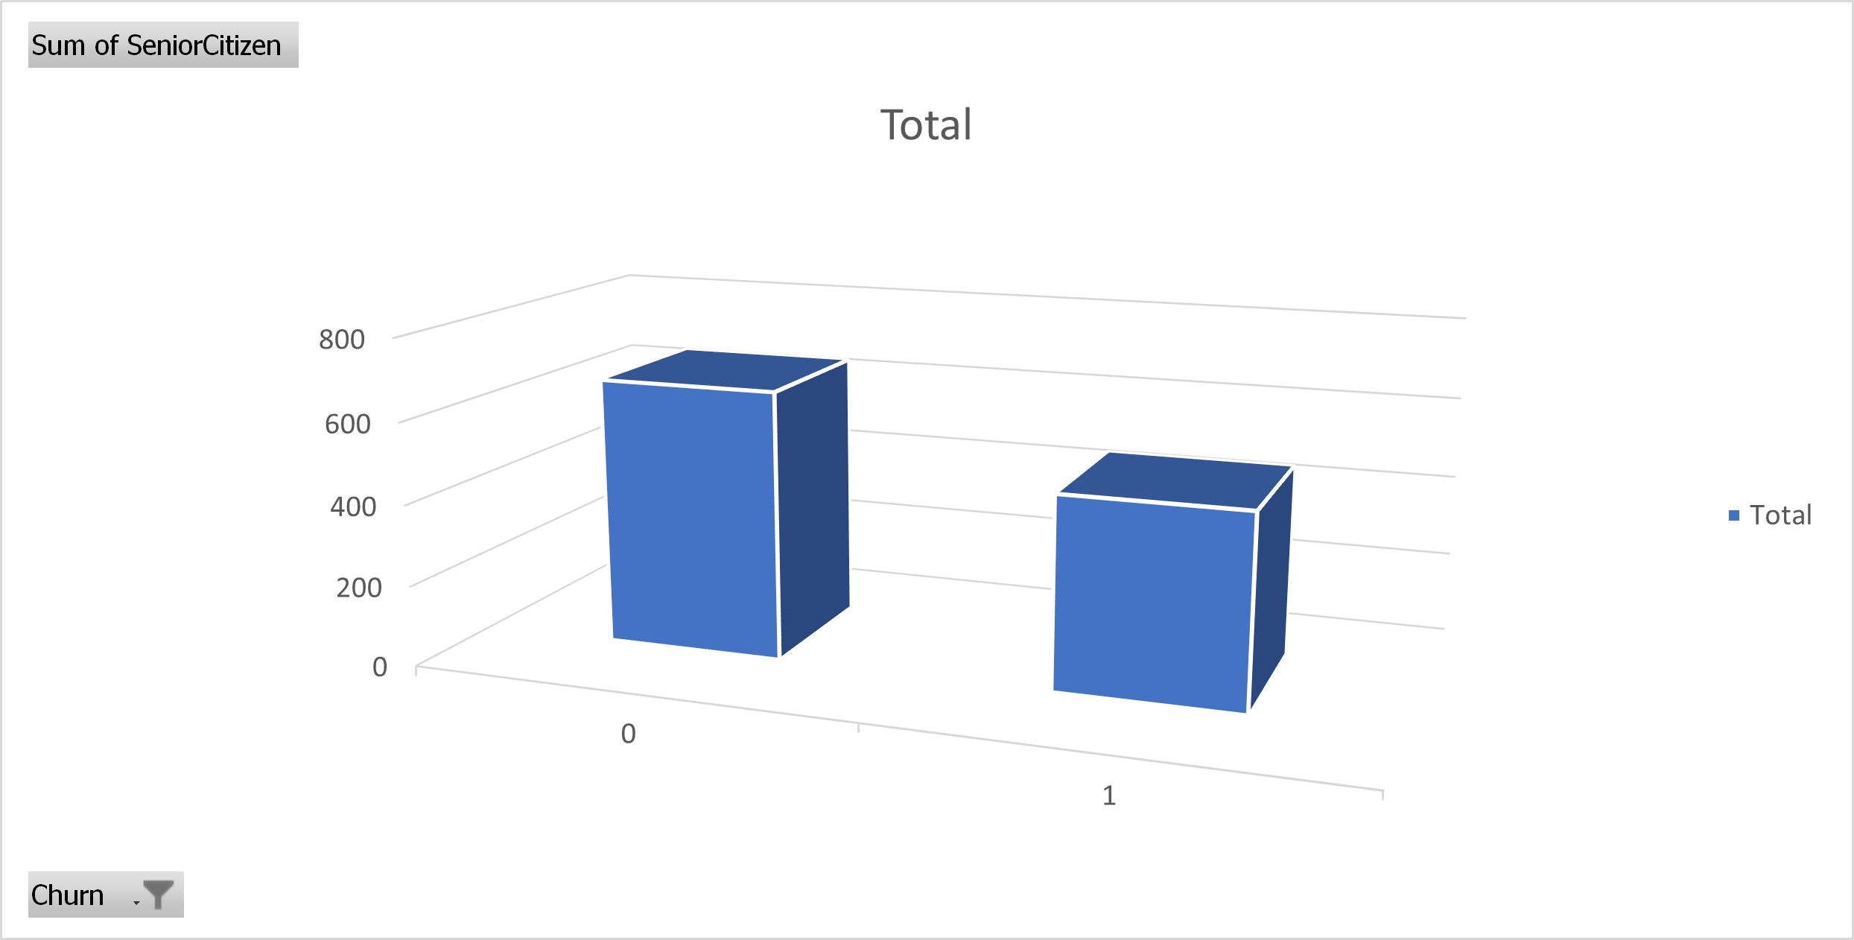
1. Whether Senior Citizen Churn Or Not? Can This Telecom Company Suggested To People Belong To Senior Citizen Category?
Row Labels | Sum of SeniorCitizen
0 | 663
1 | 475
Grand Total | 1138
Out of 1138, 663 does not churn and 475 senior citizens churned. This shows that this telecom company is good for senior citizens and it is suggestable for senior citizens.

Slide 4
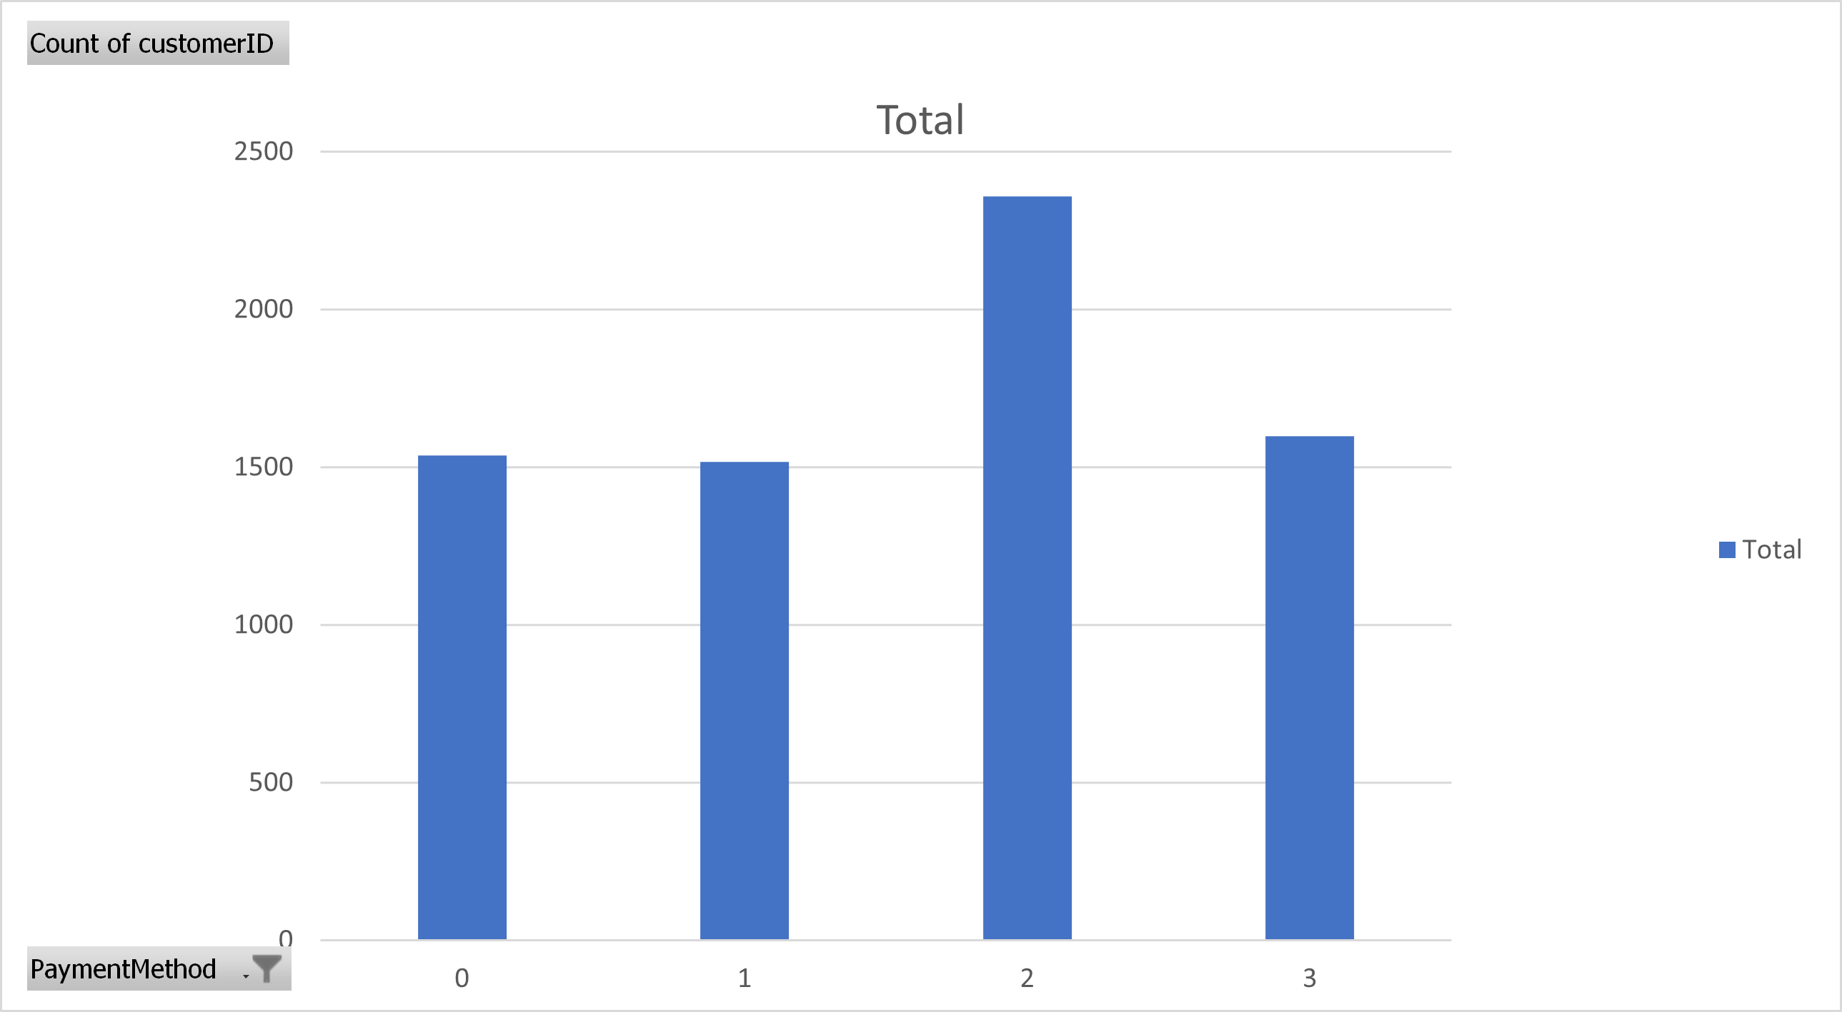
2.What payment methods customers use to pay their bills and how can the business improve using this?
Row Labels | Count of customerID
0 | 1537
1 | 1517
2 | 2358
3 | 1599
Grand Total | 7011
Out of 7011 people, 2358 people uses electronic cheque, which is the highest. So the telecom company can increase the efficiency in using the electronic cheques payment mode which helps the customers to pay their bills more efficiently, or in other side, the telecom company can advertise more to use automated billing system using credits cards as only 1517 people uses their credit card.

Slide 5
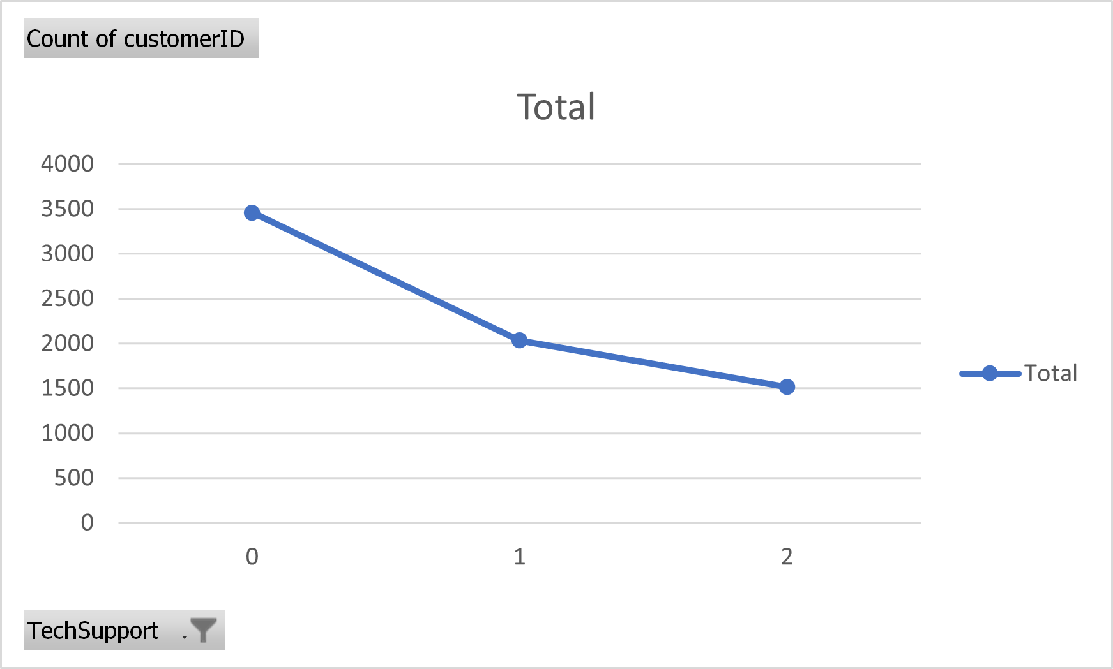
3.The additional technical support of this telecom company is working good or bad and how it is related to churn of the customers?
Row Labels | Count of customerID
0 | 3461
1 | 2034
2 | 1516
Grand Total | 7011
In a line chart, it clearly says most people doesn’t opted for additional technical support. 3461 people doesn’t want an additional technical support and 2034 people needed it.

Slide 6
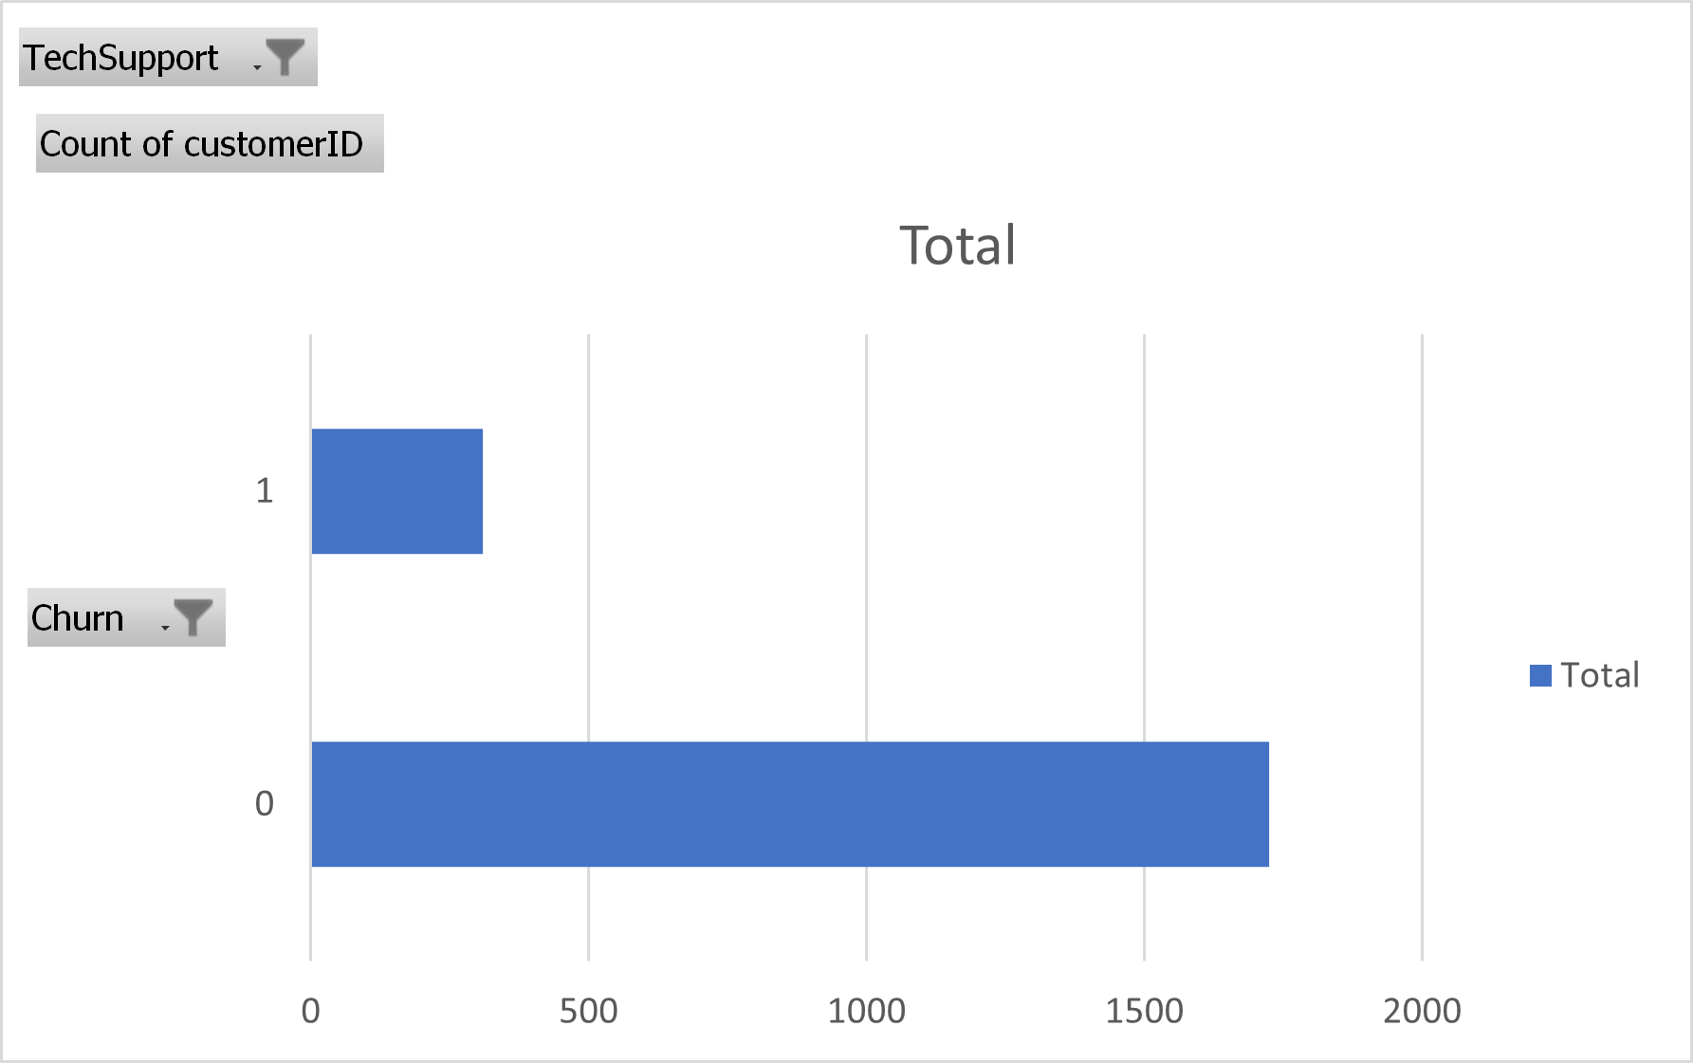
3.The additional technical support of this telecom company is working good or bad and how it is related to churn of the customers?
Count of customerID
1725
309
2034
In the next chart I have filtered a people used technical support and compared it with the churn rate. It shows out of 2034 people opted for support, 1725 does not churn and 309 customers churned. Which shows that the additional technical team of the telecom company works well and it beneficiary to the customers.

